Slide 1



AI Powered Chatbot For college website
Presented by:- Harshal vinayak Shinde
Roll No: 22
Guided By:- Prof. Trupti u. ahirrao

Slide 2
Contents
Introduction
Literature Survey
Scope & Objectives
Software/Hardware Requirements
System Architecture
Current Status
Conclusion

Slide 3

Introduction
In proposed system we are going to see a model for AI Powered chatbot for college website.
Main goal with this proposed system is a web application which gives a reply to the questions of the users.
Artificial intelligence will be used to answer the user's queries.
The user will get the appropriate answers to their queries. The answers will be given using the artificial intelligence algorithms.
Users won't have to go personally to the college for inquiry.

Slide 4
What are The Chatbots?
A chatbot is an agent that interacts with users using natural language.
A chat-bots aims to make a conversation between both human and machine.
Chatbots makes use of machine learning to reach artificial intelligence helping them to understand the user query and provide an appropriate response.
The chatbots are developed using the Artificial Intelligence Mark-up Language for communicating or interacting with the user.

Slide 5
Scope & Objectives
Scope
Highly recommendable for college/Schools website.
Highly recommendable for online shopping website.
Objectives
Reduce management effort.
Provide necessary details to student and parent online.
This application enables the students to be updated with college cultural activities.
Chatbot application saves time for the student as well as teaching and non-teaching staff.
Availability is 24x7

Slide 6
Software/Hardware requirements
Technology used
Python3, JQuery, HTML5, CSS3
Flask, chatterbot corpus, sqlite3
Software requirements
Web Browser, Python, Flask packages
For college, server side software's are required
Hardware requirements
Internet connectivity
Intel i3/AMD Ryzen3 processor based computer
4 GB RAM, min 320GB HDD

Slide 7
System Architecture
Flow Chart for proposed system

Slide 8
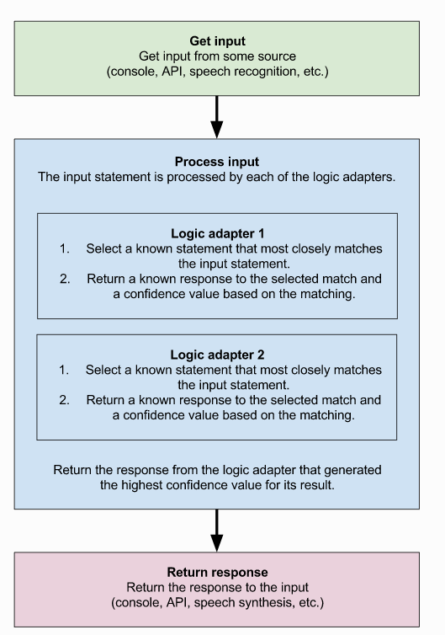
AI algorithm for chatterbot corpus
Algorithm used in proposed system

Slide 9
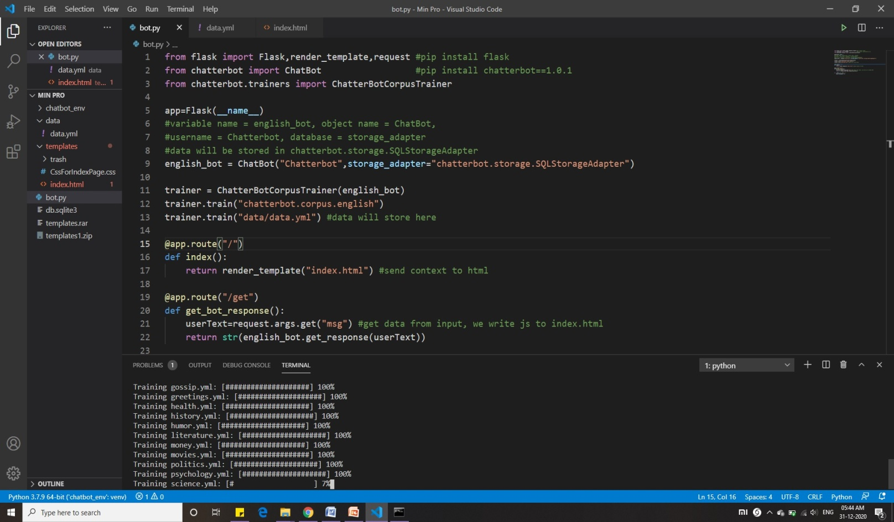
Current status
Back end Scripting: Done

Slide 10
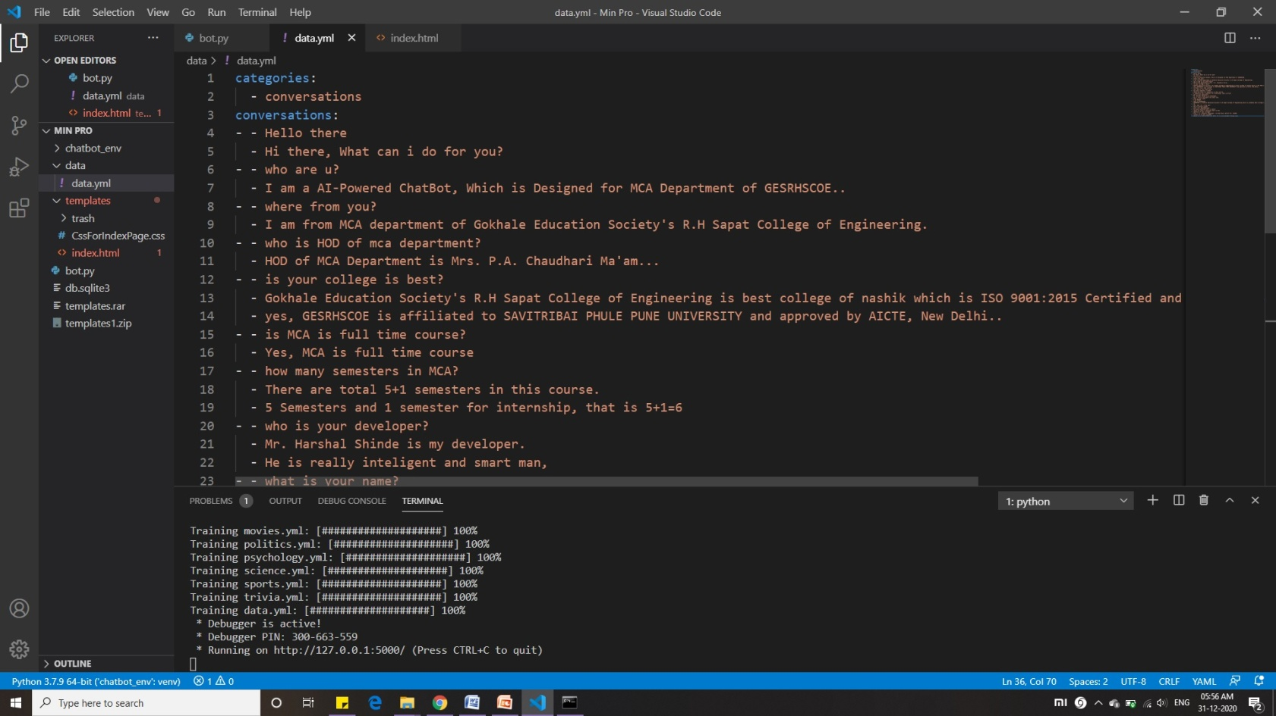
Current status
Chatbot Scripting: Done

Slide 11
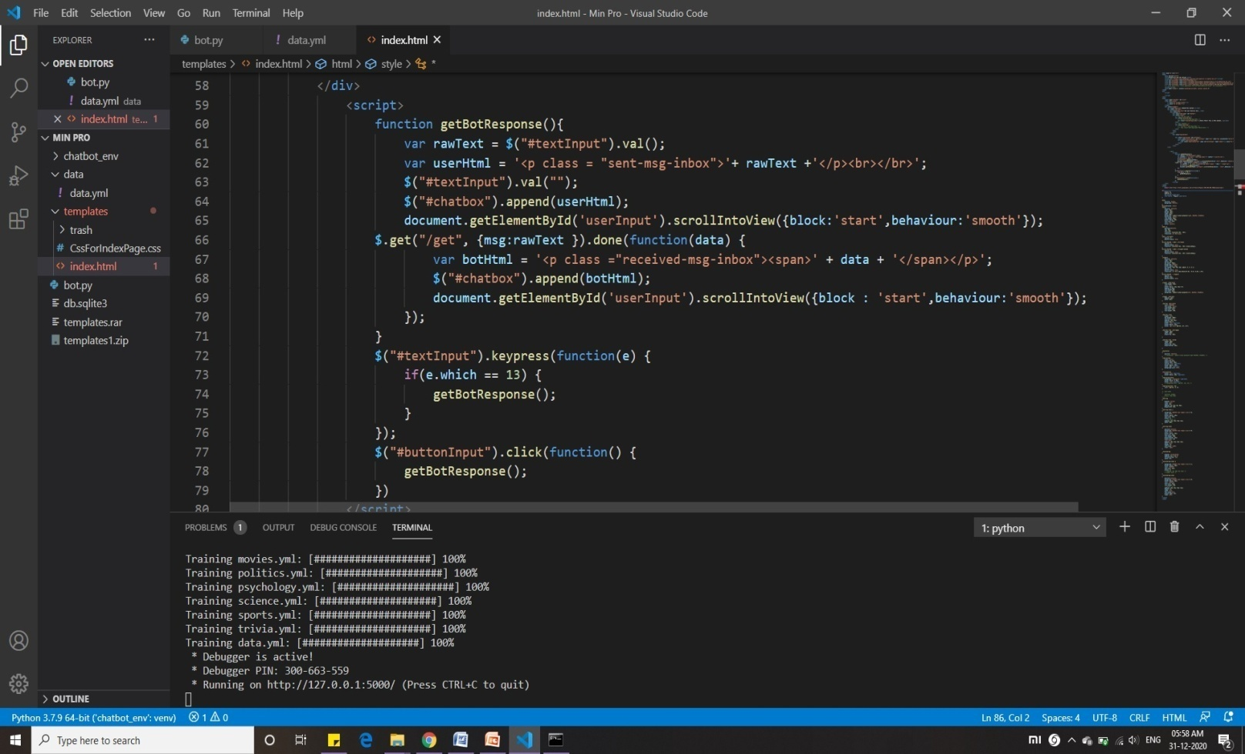
Current status
HTML and Java Scripting: Done

Slide 12
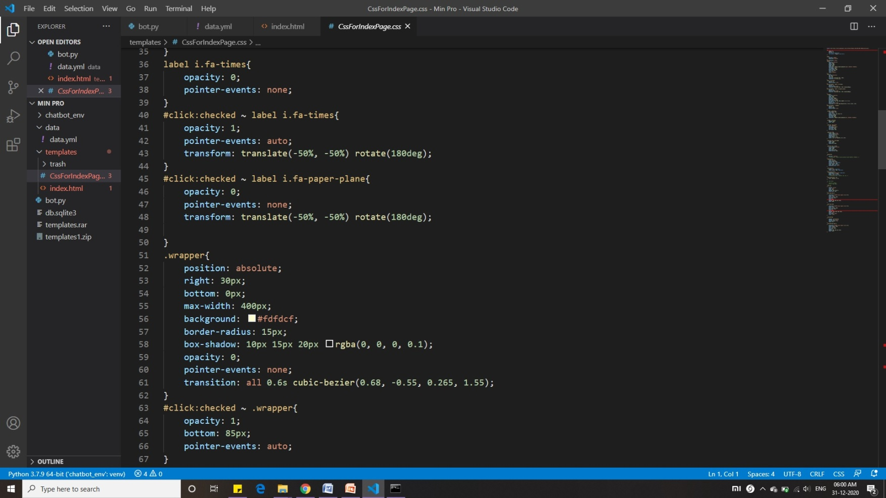
Current status
CSS Scripting and Layout Designing: Done

Slide 13
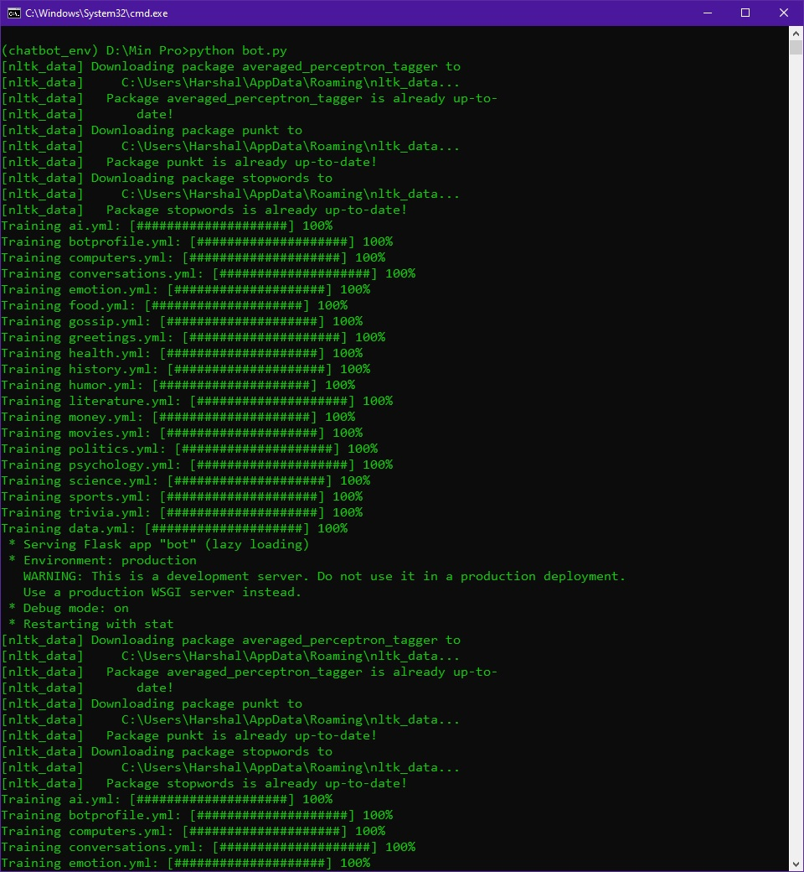
Current status
Server deployment and request handling: Done

Slide 14
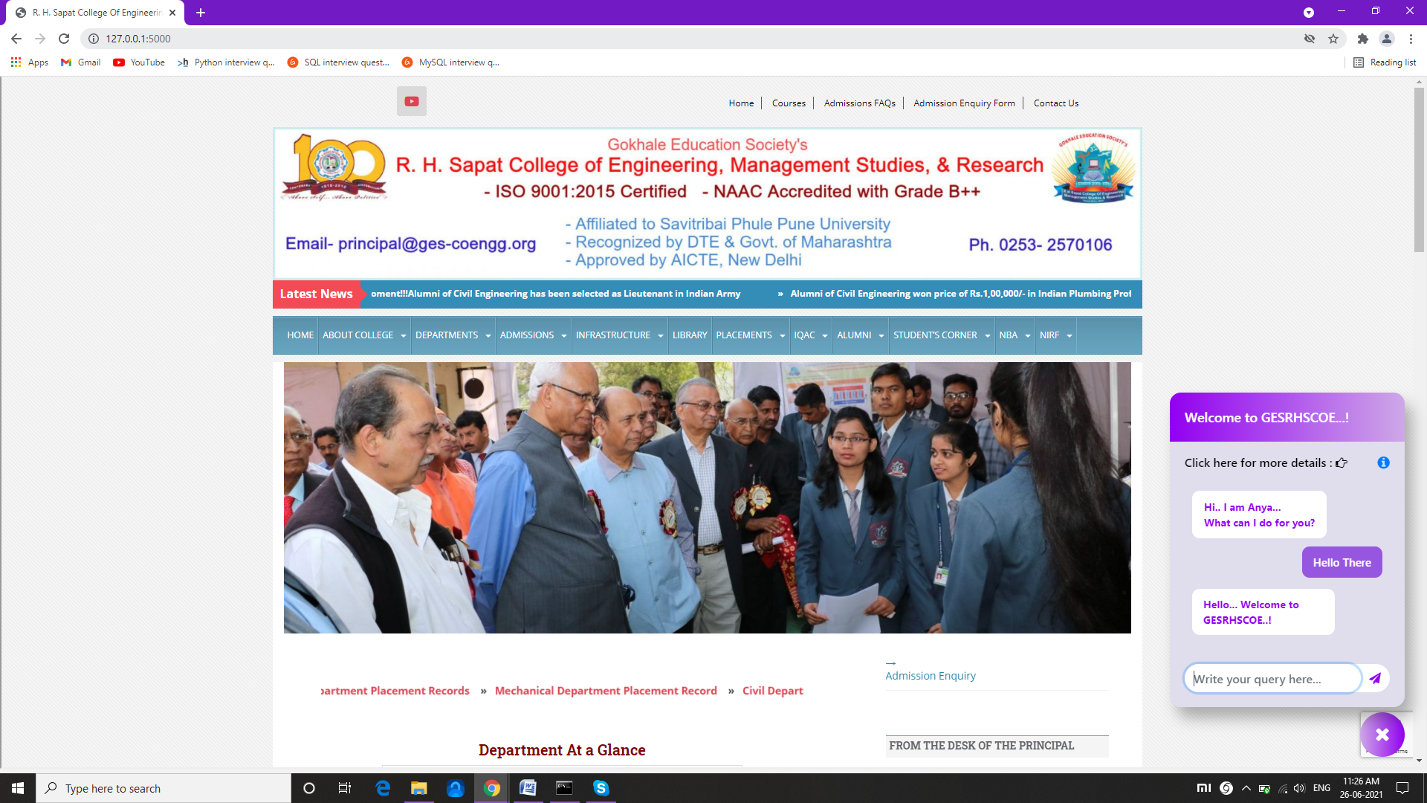
Current status
Deployment of chatbot: Done

Slide 15
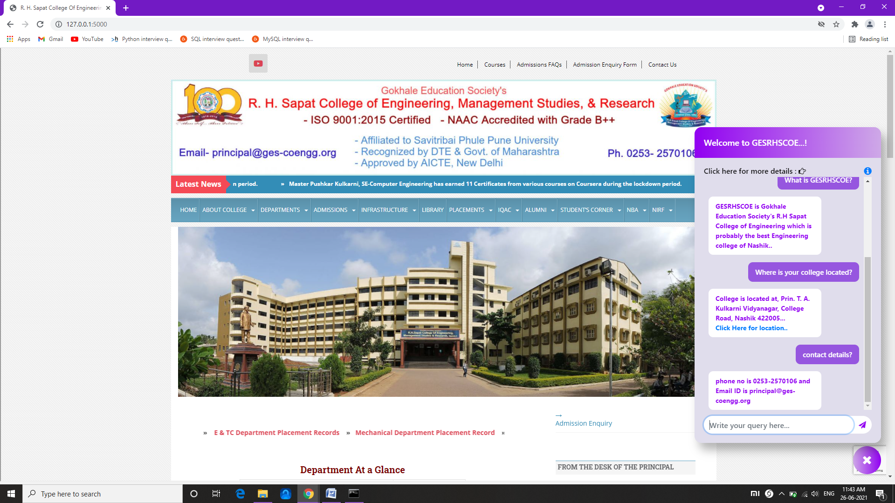
Current status
Query Handling of chatbot: Done

Slide 16
Conclusion
The main objectives is to develop an algorithm that will be used to identify answers related to user submitted questions. To develop a database were all the related data will be stored and to develop a web interface.
The web interface developed had two parts, one for simple users and one for the administrator. A background research took place, which included an overview of the conversation procedure and any relevant chat bots available.
We will create a database, which stores all the information about questions, answers, keywords, logs and feedback messages.
A usable system will be design, develop and deploy to the web server.

Slide 17
Thank You…!

